Slide 1
PFIZER SWEDEN · REGIONAL LANDSCAPE
Regional Landscape Mapping
Status update
What we have built across regions and stakeholders so far
Projektmöte · 30 april 2026
Viti Science · Sergio Flores · Mate Szilcz

Slide 2
WHAT WE HAVE MAPPED
A region-by-region picture, end to end
Six anchors describing the scale of the work
21
11
3
regions
Pfizer products
IQVIA extracts
analysed end-to-end on the same dimensions
covered across vaccines, oncology, RD/IM
Vaccines, RD/IM, Oncology — 36 months brick-level
135
8
65
stakeholders
cornerstone individuals
workbook sheets
across 21 regions × 5 roles + national tier
identified across NT-rådet, NSG, regional LK
of derived data, sources, and methodology
Captured in the master workbook and the stakeholder mapping
IQVIA layers cover April 2023 – March 2026.
Viti Science · Pfizer Sweden Regional Landscape · April 2026
2 / 6

Slide 3
REGIONS MAPPED
Same dimensions captured across all 21 regions
A consistent profile per region ready to filter, compare, or hand to the field.
Dimensions captured (per region)
Data sources
Population, demographics, 65+ growth (current and projected)
Life expectancy, cancer burden, mortality (incidence by site)
Specialist wait times, quality and access KPIs
Pfizer Rx footprint (Rx volumes and sell-in by product)
Vaccine market share and sales detail (SEK and units)
Regulatory signals (NT-rådet, TLV, RCC)
Regional governance structure (regionstyrelse, HSN, LK)
Verksamhetsplan and regional plans, where published
Named stakeholders and the regional LK ledamot pool
SCB: population, demographics, projections
Socialstyrelsen, Cancerregistret: burden and mortality
Kolada: quality, access, KPIs
IQVIA: three extracts: Vaccines, RD/IM, Oncology
Läkemedelsregistret: Rx volumes
NT-rådet, TLV: recommendation and reimbursement state
RCC: regional cancer-care signals
21 region websites: governance, plans, rosters
Public meeting minutes: committee membership
Each region has its row in the Region master sheet; 65 underlying tabs hold per-source detail.
IQVIA layers cover April 2023 – March 2026 at brick-level granularity.
Viti Science · Pfizer Sweden Regional Landscape · April 2026
3 / 6

Slide 4
STAKEHOLDERS MAPPED
135 named individuals across regional and national tiers
A 21 × 5 grid for the regions, with the national governance tier layered above.
Structure
8 cornerstone individuals
21 regions × 5 roles = 105 cells
Regiondirektör (RD)
Hälso- och sjukvårdsdirektör (HSD)
Regionstyrelsens ordförande (RS ordf)
Hälso- och sjukvårdsnämndens ordförande (HSN ordf)
Läkemedelskommittén ordförande (LK ordf)
National tier
NT-rådet — ordförande, vice ordf, members
NSG — Nationell samverkansgrupp
TLV-related contacts
Medical society and clinical-network pool
1. Mårten Lindström
NT-rådet ordförande · Region Jönköping
2. Pia Näsvall
NSG ordförande · HSD Västerbotten
3. Anders Bergström
NT-rådet vice ordförande · Region Norrbotten
4. Maria Ekelund
NT-rådet · LK ordf Region Jönköping (dual)
5. Jan Melin
NT-rådet · LK ordf Region Uppsala (dual)
6. Mats Ek
LK ordförande Region Stockholm
7. Johan Bratt
NSG referensperson · Chefläkare Region Stockholm
8. Rickard Malmström
NT-rådet · Stockholm LK vice ordf (dual)
Cornerstones selected by composite influence score from the 135-name pool. Three of eight sit in Stockholm; the full Stockholm LK ledamot pool (17 names) is captured beneath them.
Viti Science · Pfizer Sweden Regional Landscape · April 2026
4 / 6

Slide 5
COVERAGE AND PENDING
Where coverage stands
Contact coverage at 90% across the 135-name pool; a handful of items still tracking.
Contact coverage
Items still tracking
90%
Region Gävleborg verksamhetsplan
Site reorganisation broke the URL — manual retrieve.
Region Sörmland verksamhetsplan
2026 plan not yet publicly published at our pull date.
Cornerstone-tier email verification
Pia Näsvall (URL only) and Johan Bratt (missing from contacts sheet).
21 individual region profiles
Defined add-on workstream — underlying data already in workbook.
Per-region GRP normalisation
Per-100k everywhere today; additive on request.
of the 135 named stakeholders have captured contact information
Coverage spans every region and the national tier — every cell holds either a captured name or a flagged gap.
Cornerstone-tier subset can be field-validated by Pfizer
Viti Science · Pfizer Sweden Regional Landscape · April 2026
5 / 6

Slide 6
PFIZER SWEDEN · REGIONAL LANDSCAPE
Draft slides example

Slide 7





PART B: REGION STOCKHOLM
Region Overview
Healthcare region: Stockholm-Gotland
Demographics
Population Projections
2,473,307
16.9%
833 kSEK
2,631,239
564,308
2,747,015
Population
65+ share
GRP/capita
Pop 2040
65+ in 2040
Pop 2050
+35%
84.4 yrs
27.6%
25,657
495,084
25,673
65+ by 2040
Life expectancy
Foreign-born
Births 2024
Women 15-44
Infants 0-1
Healthcare Budget
Health Equity Indicators
35,421 SEK
3,104 SEK
5,722 SEK
153.4/100k
41.1/100k
12.4/100k
HC cost/capita
Pharma/capita
Primary care/cap
Premature mort. 25-64
HC-amenable mort.
Suicide 25+
8.8%
85 SEK
4,119
58.6%
5.5%
46.5%
Pharma % of HC
Vaccine sell-in/cap
Specialists
Post-secondary edu
Daily smokers
Overweight/obese
Source: SCB, Kolada, Folkhälsomyndigheten (2024)

Slide 8




PART B: REGION STOCKHOLM
Disease Burden & Epidemiology
Cancer Burden
Pipeline Therapeutic Areas
207.9/100k
185.1/100k
38.1/100k
Obesity
46.5% overweight/obese prevalence in Stockholm. Among the lowest nationally but still affecting nearly half the adult population.
Prostate cancer
185.1/100k incidence (4,578 implied cases). 5th highest nationally. Stockholm is the largest patient pool by volume.
Lung cancer
38.1/100k incidence (944 implied cases). Mortality 45.9/100k. 5.5% daily smokers (lowest nationally).
Breast cancer
Prostate cancer
Lung cancer
~5,141
~4,578
~944
Implied breast cases
Implied prostate cases
Implied lung cases
56.8%
38.9%
45.9/100k
Breast screening detect
Breast surg <28d
Lung ca mortality
Infectious Disease Epidemiology
Cardiovascular & Rare Disease
137
5.5/100k
105
MI incidence: 207.2/100k (prevalence 193/100k)
Heart care quality: 92.6/100 (highest nationally)
ATTR-CM (Vyndaqel): 82 patients (3.32/100k). 93.7% market share.
Haemophilia (Hympavzi): BeneFIX 40.6M SEK + Refacto AF 382k SEK (3yr). Largest haemophilia market nationally.
TBE cases 2025
TBE incidence
TBE cases 2024
357
14.4/100k
323
IPD cases 2025
IPD incidence
IPD cases 2024
261/1,000
91.8%
86.1%
Antibiotic Rx
MPR 2yo coverage
HPV girls coverage
Source: Socialstyrelsen, RCC, Folkhälsomyndigheten, IQVIA (2024-2025)

Slide 9
PART B: REGION STOCKHOLM
Pfizer Product Portfolio
Product | Indication | Pts 2024 | /100k | 3yr SEK (M) | NT-rådet | Trend
Vyndaqel | ATTR Cardiomyopathy | 82 | 3.32 | 283.5 | Nat'l agreement | Growing
Ibrance | HR+/HER2- Breast Ca | 155 | 6.27 | 73.7 | Regional disadv. | Declining
Lorviqua | ALK+ NSCLC | 9 | 0.36 | 37.8 | RCC decision | Stable
Tukysa | HER2+ Breast Ca | 15 | 0.61 | 13.2 | NT recommend. | Growing
Elrexfio | Multiple Myeloma | — | — | 80.8 | NT recommend. | Launch
Talzenna | BRCA Breast Ca | 6 | 0.24 | 5.1 | Nat'l agreement | Stable
Vydura | Migraine | 974 | 39.38 | 18.9 | — | Growing
Paxlovid | COVID-19 | 267 | 10.80 | 21.2 | — | Variable
Hympavzi | Haemophilia | — | — | — | Pipeline | Pre-launch
Total Pfizer Footprint: 1232M SEK (3yr) | Vaccines: 401M | RD/IM: 365M | Oncology: 467M
Note: Xtandi (enzalutamide, prostate cancer) contributes 251M SEK (3yr) but is co-marketed with Astellas. Included in oncology total.
Pipeline: Borrelia/Lyme vaccine (epidemiology mapping only). TBE incidence 5.5/100k in Stockholm provides a reference for tick-borne disease burden in the region.
Source: IQVIA Sell-In (Apr 2023 - Mar 2026), Socialstyrelsen, samverkanlakemedel.se

Slide 10


PART B: REGION STOCKHOLM
Vaccine Landscape
TBE (FSME-IMMUN)
Regional Vaccination Coverage
Pfizer share: 78.6% | Total market: 457M SEK | Pfizer: 360M SEK
Endemic area. 137 TBE cases (2025). Pfizer dominant.
91.8%
86.1%
MPR 2yo (lowest nationally)
HPV girls
85 SEK
261/1k
RSV (Abrysvo)
Vaccine sell-in/capita
Antibiotic Rx rate
Pfizer share: 59.9% | Total market: 43M SEK | Pfizer: 25.9M SEK
Growing market. 65+ population key target.
Market Penetration Scores
Pneumococcal (Prevenar)
TBE (FSME-IMMUN): Burden score 95/100, Gap score 40/100, Opportunity 67.5/100
Per capita/yr: 48.5 SEK | Pfizer share: 78.6%
IPD (Prevenar): Burden score 70/100, Gap score 45/100, Opportunity 57.5/100
Per 65+/yr: 12.6 SEK | Pfizer share: 12.4%
Pfizer share: 12.4% | Total market: 127M SEK | Pfizer: 15.8M SEK
Low Pfizer share. 357 IPD cases (2025). Gap opportunity.
Source: IQVIA Sell-In (3yr), Folkhälsomyndigheten, Viti Science analysis

Slide 11


PART B: REGION STOCKHOLM
Governance & Stakeholder Engagement
Key Decision-Makers
Top Product Priorities
Regional Director
Emma Lennartsson
1
Vydura (migraine)
Score: 75.8 | High opportunity, large patient volume
Healthcare Director
Anders Ahlsson
2
Tukysa (HER2+ BC)
Regional Council Chair
Aida Hadžialić (S)
Score: — | Strong uptake, NT agreement in place
HC Board Chair
Anna Starbrink (L)
3
FSME-IMMUN (TBE)
Drug Committee Chair
Mats Ek
Score: — | 78.6% market share, endemic area
Archetype: Academic specialist
NT-rådet Rep
Rickard Malmström
Competitor Pipeline Threats
NSG Rep
Johan Bratt
Enhertu (AstraZeneca/Daiichi)
HR+ HER2-låg/ultralåg breast cancer, 2L post-endokrin. Affects: Tukysa
Top Influence Scores
Tecvayli (Janssen/J&J)
Multipelt myelom 2L kombination med daratumumab. Affects: Elrexfio
Rickard Malmström: 114
Johan Bratt: 102
Verzenios (Eli Lilly)
CDK4/6 inhibitor — HR+/HER2- breast cancer (2L+ and adjuvant). Affects: Ibrance
Mats Ek: 75
Source: samverkanlakemedel.se, IQVIA, SKR, Viti Science analysis (2024-2026)

Slide 12

PART B: REGION STOCKHOLM
Competitive Landscape & Strategic Positioning
CDK4/6 Competitive Landscape
Opportunity x Actionability Quadrant
Ibrance: 3762 units (23.2%)
Δ: -18.5%
Verzenios: 6556 units (Δ +114.4%)
Kisqali: 5930 units (Δ +24.9%)
Ibrance -18.5% → primarily Verzenios (+114.4%)
Priority Focus (HH): Paxlovid, Vydura, Tukysa, Vyndaqel, Talzenna, Elrexfio, Lorbrena/Lorviqua, Abrysvo, Prevenar 20, Hympavzi, Ibrance
Engagement Build (HL): None
Quick Win (LH): None
Deprioritize (LL): None
GRP-Adjusted Pharmaceutical Usage
Stockholm has the highest GRP per capita (833 kSEK) but pharma cost per capita (3,104 SEK) is below the national average. This suggests room for increased pharmaceutical utilisation relative to the region's economic capacity. Vaccine sell-in per capita (85 SEK) is mid-range nationally. The combination of high GRP and moderate pharma spend positions Stockholm as a region where increased investment in specialty products could be justified to payers.
Strategic Summary
→ Largest patient pool nationally (2.5M pop, 23.5% of Sweden)
→ Lowest CDK4/6 Pfizer share among major regions (defend Ibrance position)
→ Vyndaqel stronghold (93.7% ATTR-CM market share, 283M SEK)
→ Largest haemophilia market (Hympavzi launch opportunity)
→ TBE endemic with 78.6% vaccine share (maintain leadership)
→ Low Prevenar penetration (12.4% share, gap opportunity)
Source: IQVIA, SCB, Viti Science composite analysis (2024-2026)

Slide 13
QUESTIONS
Questions
Confirm slides format
Drug data from SOS Open Database vs Internal AVA Apps data
Confirm Scope (e.g. interest in opportunity score,
Deadline
Viti Science · Pfizer Sweden Regional Landscape · April 2026
5 / 6

Slide 14
PFIZER SWEDEN · REGIONAL LANDSCAPE
Tack!
Sergio Flores · Viti Science · sergio.flores@vitiscience.se
Mate Szilcz · Viti Science · mate.szilcz@vitiscience.se

Slide 15
PFIZER SWEDEN · REGIONAL LANDSCAPE
Placeholders

Slide 16
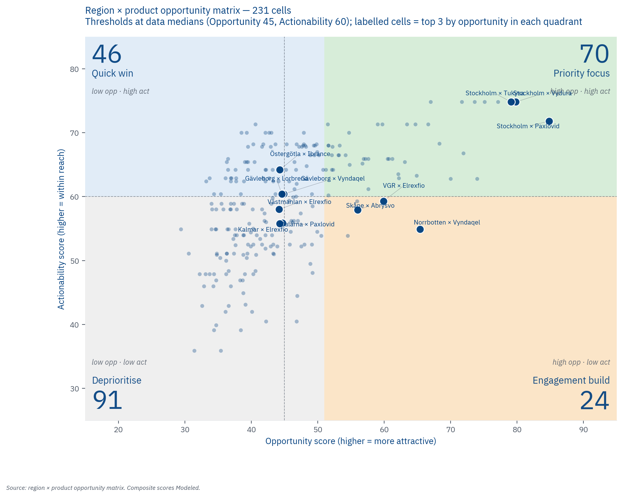
REGIONS MAPPED
Opportunity matrix
Twenty-one regions multiplied by eleven products gives 231 cells
we score every one of them on seven dimensions before aggregating to a single 0–100 Opportunity composite.
The seven dimensions are
epidemiological fit (weight 25%),
current uptake (10%),
growth pressure (15%),
access friction (10%),
stakeholder leverage (15%),
competitive threat (15%), and
policy relevance (10%).
Viti Science · Pfizer Sweden Regional Landscape · April 2026
3 / 6

Slide 17
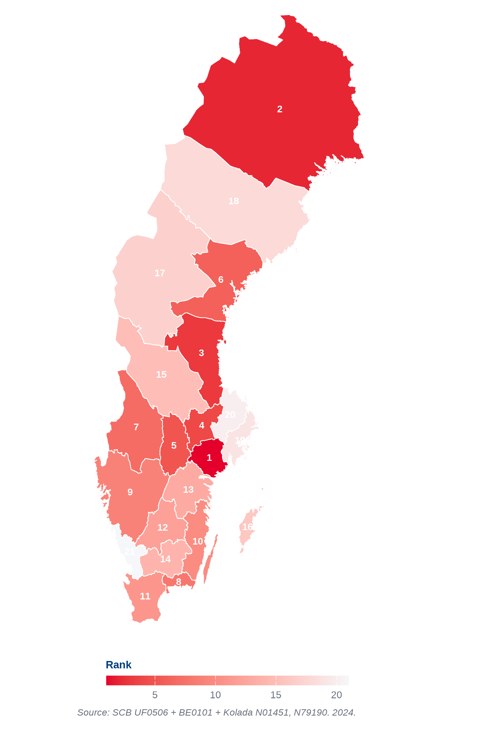
REGIONS MAPPED
Health equity composite rank: unmet need across all 21 regions
A consistent profile per region ready to filter, compare, or hand to the field.
Composite of four indicators that together describe unmet need
foreign-born share
post-secondary education share for ages 25–64
age-standardised premature mortality 25–64
three-year moving average healthcare-amenable mortality
The five regions where unmet need ranks highest on this composite:
1. Sörmland
2. Norrbotten
3. Gävleborg
4. Västmanland
5. Örebro
Viti Science · Pfizer Sweden Regional Landscape · April 2026
3 / 6

Slide 18
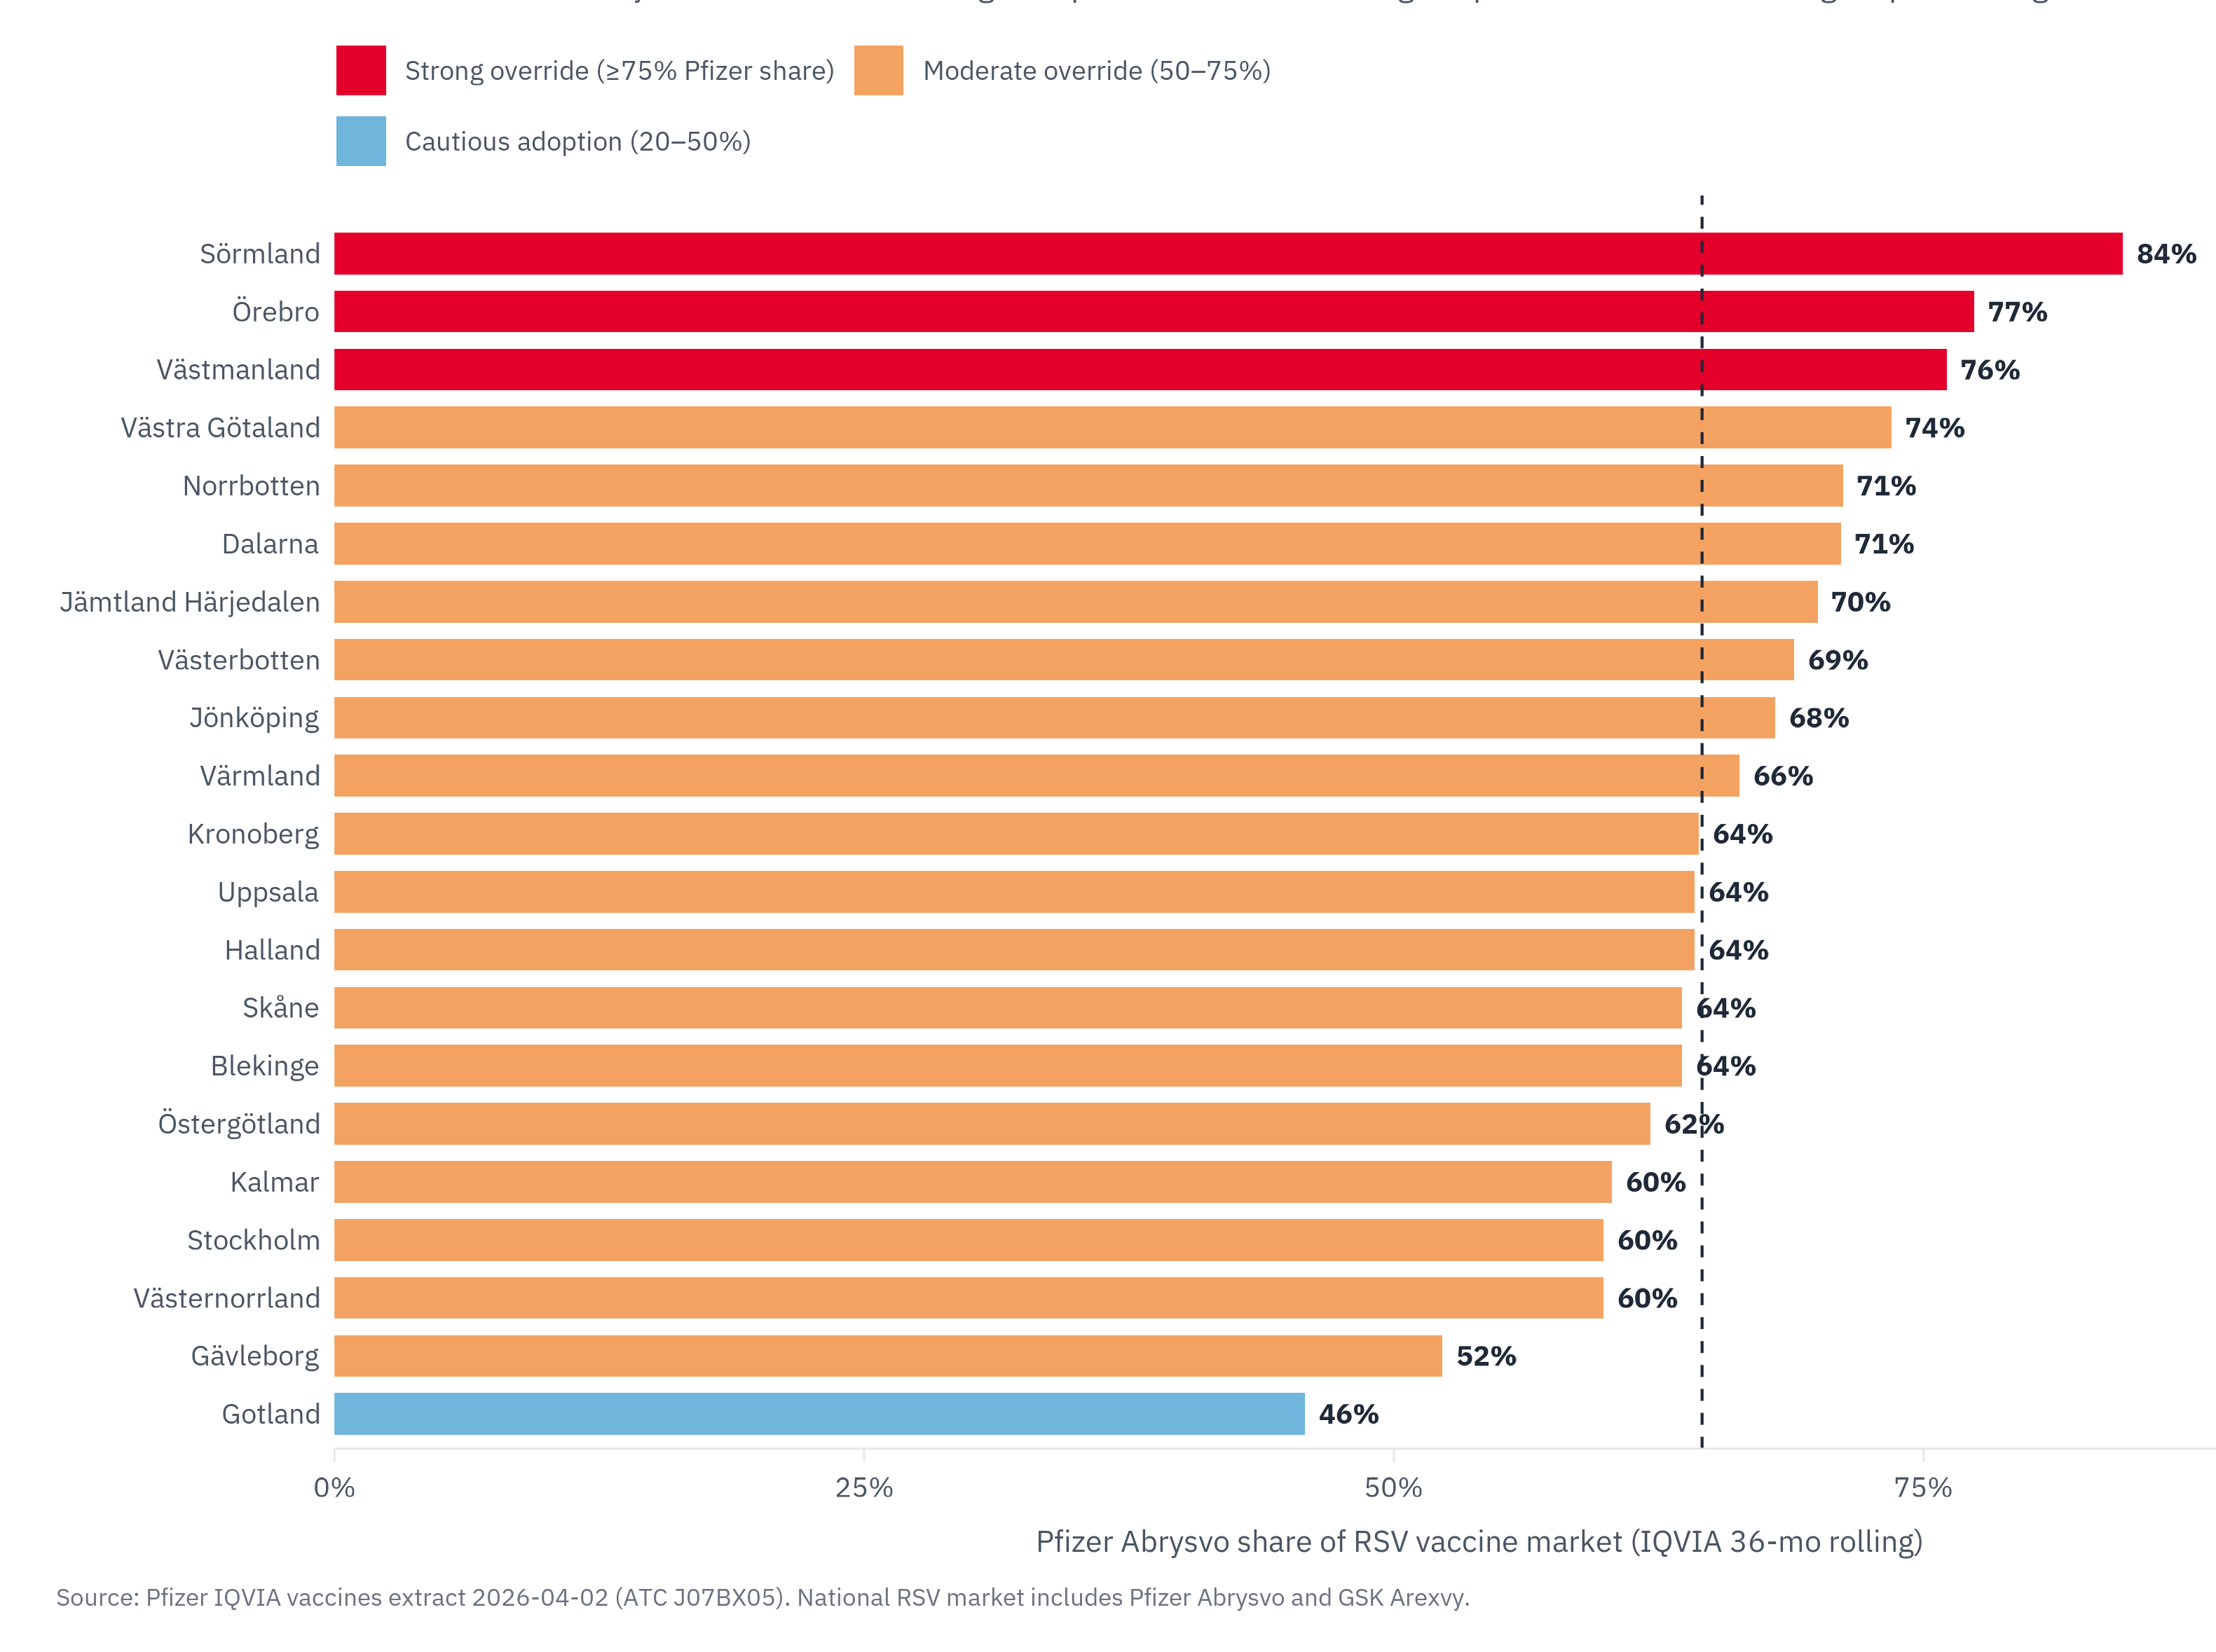
REGIONS MAPPED
Adult-vaccine demographic tailwind
Adult vaccines are the single most-aligned Pfizer category to Sweden's demographic trajectory.
Sixteen of twenty-one regions carry the Aging vaccine-growth tag, set by a 65+ share above 22% or 65+ growth above 25% to 2040.
Abrysvo's 64.5% national share by SEK (56.8% by units) despite NT-rådet "avvakta" shows that regions are already adopting
Viti Science · Pfizer Sweden Regional Landscape · April 2026
3 / 6

